Slide 1
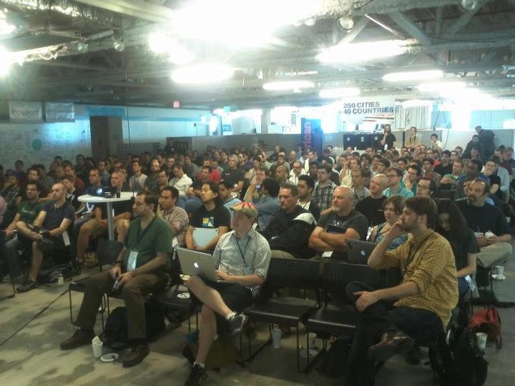

Source: @boazsender

Slide 2
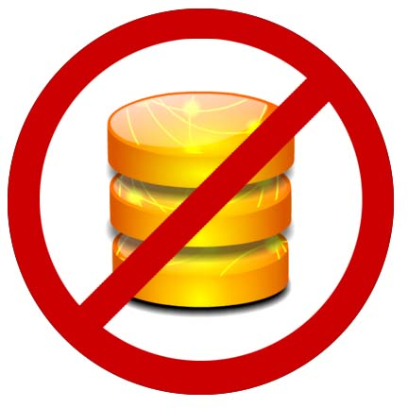
What Will NOT be Covered
DB Stuff -> Serializing your model into the document
DB Stuff->Upserting changes to restful endpoints
Unit Testing your Models
Backbone Routers, History

Slide 3
What WILL be Covered: the basics of client-side MV* frameworks
Models
Views
How to connect them via publish/subscribe

Slide 4
Spay-Query
//spay-query
$(document).ready(function () {
//fields in global scope
var Likes = 0;
var Title = 'Great Expectations';
//manual event wireups in document ready
$('#').click(function () {
Likes = Likes + 1;
//calls to funcs in global
UpdateLikes();
});
});
function UpdateLikes() {
//save to db - >
$.ajax('/url', Likes, function () {
//string concats
$('#books').append('<li>' + Title + '(' + Likes.toString() + ')</li>');
});
}

Slide 5
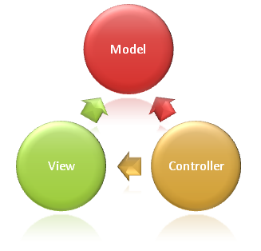
Server Side MVC Frameworks connect models and views with HTTP verbs: GET, POST, etc. over the Request/Response Cycle

Slide 6
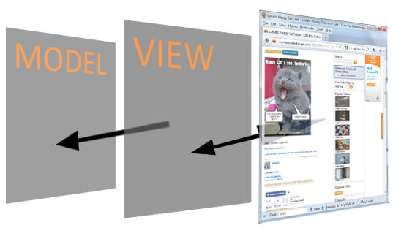
Client Frameworks connect models and views and respond to DOM events onclick, etc. in the window.
No longer simulating a stateful a process

Slide 7
Some of the Players
Backbone.js
Knockout.js
Ember.js
Spine.js
Jquery UI widgets (not flexible enough)
A whole slew of others, but it is the first two that have the most momentum right now

Slide 8
What is Backbone?
-base classes
-system of conventions

Slide 9
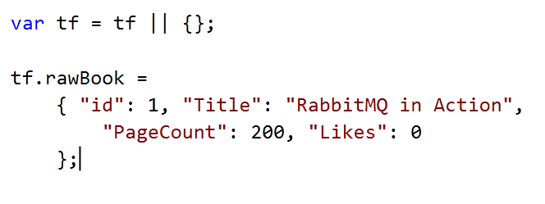
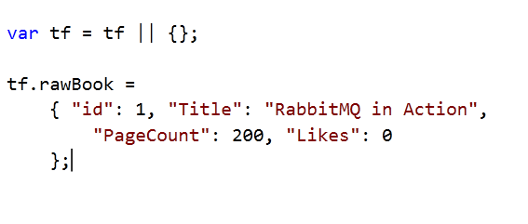
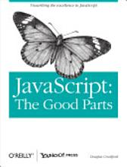
Consider this Book Data Model

Slide 10
Pretty Simple:
Extend Backbone.Model and create instance
Extend Backbone.View and create instance that references the model
Call viewinstance.render() and append el property to DOM

Slide 11
BackBone.Model
Prototype for your JSON data object that adds:
Attributes dictionary - Getter/Setter
Event subscription
Built-in plumbing for saving back to server (not covered)
Your Custom methods

Slide 12
Views are used to generate a DOM node with HTML content and events that references an underlying MODEL instance
Reference a model
Override render()
Configure event delegates

Slide 13

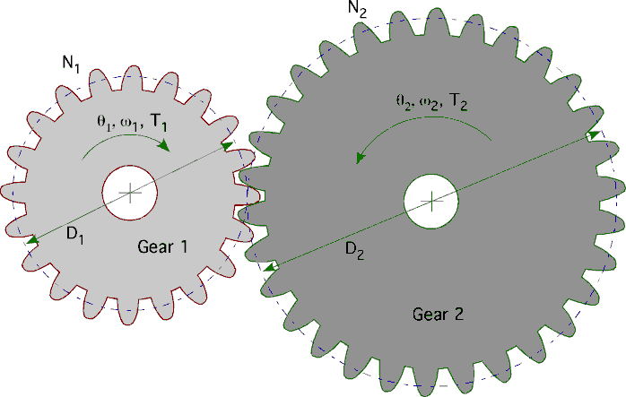
So what?? BFD, this looks like a LOT of code and all it does it increment likes.
Maintainable
Maintainable
Maintainable

Slide 14
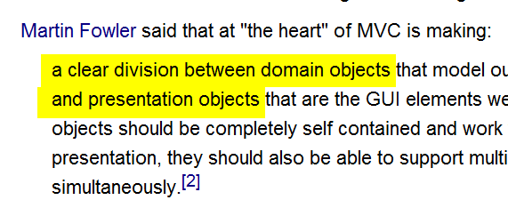

A Guru Speaks
Source: Wikipedia article on MVC

Slide 15
BackBone.Collection & More
Model Reuse
Array of Model with add/remove callbacks, array extensions

Slide 16
The Stack
Client (DOM, MV*)
Service layer (webapi, sinatra, node)
Db – (mongo / couch / sql)

Slide 17
What Else?
Service Layer-Restful ASP.NET Web API John V. Petersen 1:45pm
Node.js: A Guided Tour - C. Aaron Cois – 9.45
JavaScript Testing John V. Petersen at 3:15pm
Underscore.js
Getting Started with MongoDB and .NET -Jeremy Jarrell 1:45pm
Validation is built in, but best for mobile/quick hits

Slide 18
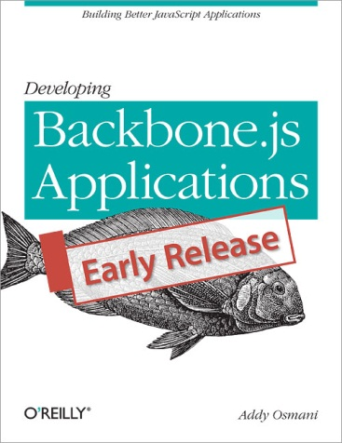
Final Observations
There is a landscape of MV* frameworks
Backbone is deep/flexible and unveils itself at your pace
Little code, more convention
The awesome documentation, books – Addy Osmani

Slide 19

Client Side Technology is already pretty mature – right now
The apps you know and love are using it
Viva the client-side utopia!

